Slide 1











Notes:
DO NOT UNHIDE THIS SLIDE. There is an action button on the title slide to activate the waiting slide.
Waiting Slide. This is the slide displayed until everyone is ready for the presentation. Use it as a background to do some small talk, roundtable, wait for participants to arrive.
TO START THE PRESENTATION, click esc.

Slide 2

Problem management
Starter Pack Training Material
Notes:
Click on the Apptio Logo to launch the hidden Waiting Slide.

Slide 3
Agenda
ITIL Problem Management
ServiceNow Overview
Problem Handling
Additional Functionalities
Exercises

Slide 4
INTRODUCTION

Slide 5
PROBLEM MANAGEMENT PROCESS
Problem definition:
Unknown underlying cause of one or more Incidents
Deviation from the expected norm
Objectives of the ITIL Problem Management process:
Minimize the adverse effect on business of Incidents and Problems caused by errors in infrastructure
2 ways to open a Problem:
Proactively: Resolving Problems proactively prevent the occurrence of Incidents and Errors
Reactively: When the Problem is open after one or many Incidents have been reported

Slide 6
ITIL PROCESS FLOW (1/2)
Service Desk
Event Mgt
Incident Mgt
Proactive Problem Mgt
Supplier
Problem Detection
Problem Logging
Problem Categorization
Problem Prioritization
Investigation & Diagnosis
Source: ITIL2011

Slide 7
ITIL PROCESS FLOW (2/2)
Investigation & Diagnosis
Communicate workaround
yes
Work Around?
no
no
Resolution identified?
yes
Define as Known Error
yes
Change Needed?
Change Management
no
Resolution & Recovery
Closure
Source: ITIL2011
END

Slide 8
Servicenow overview

Slide 9
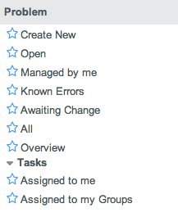
APPLICATION & MODULES
Access to a blank problem creation form
List of all active problems (New, In progress and Awaiting statuses)
List of all problems the user is handling
List of Problem records marked as “Known Errors”
List of all inactive problems (Closed status)
List of all problems
Problems overview page (dashboard)
Problem Tasks assigned to the user
Problem Task assigned to the group of the user.
1
2
3
4
5
6
7
8
9

Slide 10
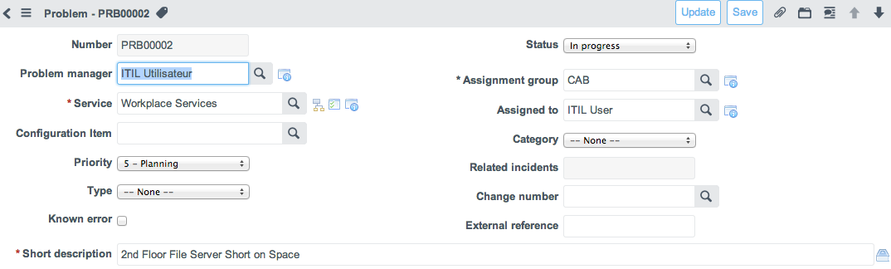
PROBLEM FORM
1
a
2
b
3
c
4
d
5
e
6
Problem Number
To identify the affected manager
To identify the impacted Service
To identify the Configuration Item (CI)
To select the priority
To select the type, proactive/reactive
a. Status to manage the problem lifecycle
b. assign the problem to a specific group
c. assign the problem to a specific agent
d. categorize the problem
e. Related Incidents counter
Orange= automated field

Slide 11
PROBLEM ACTIONS
1
2
3
4
To save the problem and go back to list
To save the problem
To attach documents
To move to the previous/next record

Slide 12
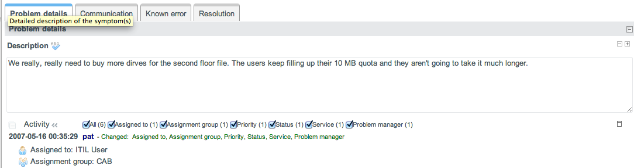
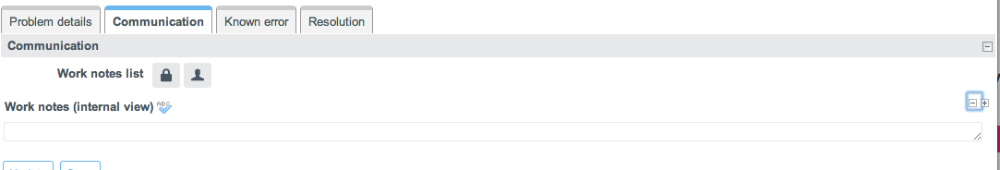
sections: problem details /Comments
1
2
Full description of the Problem
Activity formatter: all actions on the current record are audited and displayed in the Activity section
Watch List: List of people who will receive the notifications about the current Problem record
Internal Work notes journal
3
4

Slide 13
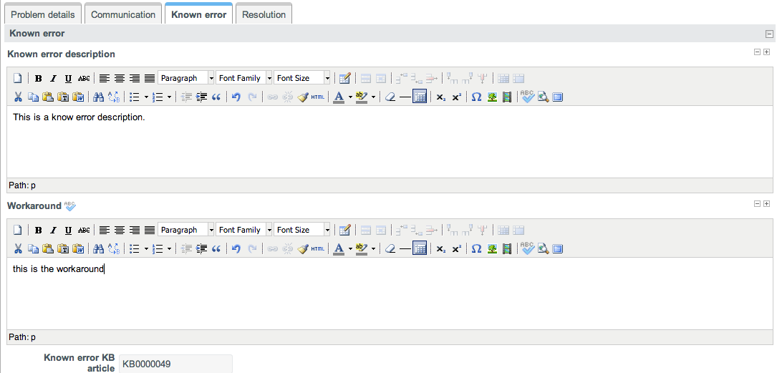
sections: workaround
1
2
3
Known error description
To describe the temporary workaround until a permanent solution is found.
Reference to the Known Error Knowledge Base Article (if Known Error has been published to the KB)

Slide 14
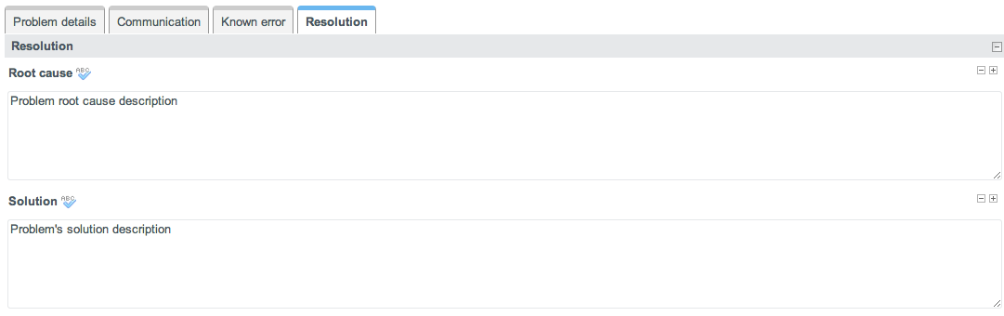
sections: Resolution
1
2
Problem’s root cause description
Problem solution description

Slide 15
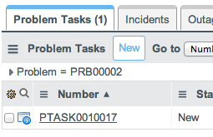
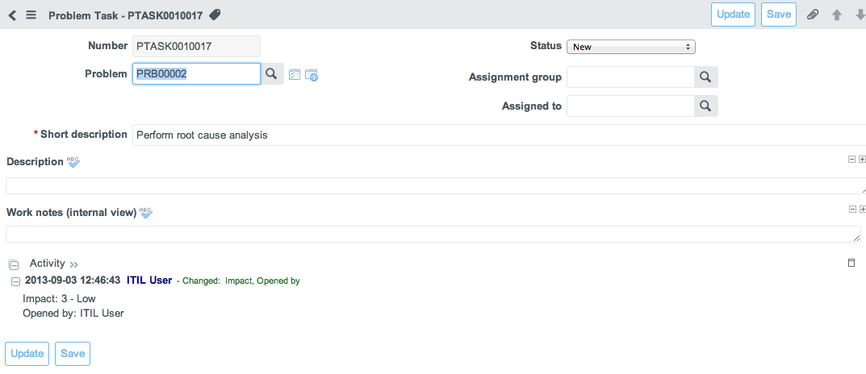
Problem tasks
1
Problem Tasks can be created from Problem Tasks related list:
Problem Task form:
Problem to which the Problem task is linked.
Problem Task Status
Assign Problem Task to specific Group or Agent.
b
a
c

Slide 16
Problem HANDLING

Slide 17
PROBLEM LIFE-CYCLE
1. Creation
2. Investigation and Diagnosis
3. Change needed?
4. Resolution & Recovery
5. Closure

Slide 18
1. PROBLEM CREATION
A problem can be created from an existing incident or proactively to prevent a future issue
Step | In ServiceNow
1a. Create a problem from an incident (reactive). Usually logged by the Service Desk | Open the related incident > right-click in the form header bar and select “Create Problem”. Copied fields are: “Business Service” “CI” “Short Description” “Description”
1b. Create a standalone problem (proactive). Usually logged by Problem Management | "Problem" > "Create New” In the “Business Service” field search for the impacted service If known, select the “CI” impacted by the problem Update the problem “Short Description”
2. Describe the problem | Document the problem to the best level of detail based on the symptoms using the “Description Field”
3. Identify other existing incidents related to this problem (Problem Matching) | Select “edit” from the “Incidents” related list at the bottom of the problem form and “add” incidents known to be related to this problem
4. Assign the Problem to the appropriate Problem Management group | Search and Select the appropriate “Assignment Group”  Email notification sent to the group
5. Save and Close the Problem | Click on “Update”  Email notification sent to problem creator

Slide 19
CATEGORIZATION
The problem categorization matches the sub-categories of a “Failure incident” :
Category | Description/Examples
Connectivity | Issue with network such as LAN, WAN, etc.
Data | Data integrity, missing, corrupted. e.g. incorrect data load
Facilities | e.g. power generator down, Air Conditioning down
Hardware | Hardware failure e.g. computer monitor does not turn on
Security | e.g. Denial of service attack, virus, etc.
Software | Software bug, etc.

Slide 20
PRIORITIZATION
Problem prioritization is performed using the Priority field of the problem form.
5 levels of priority are available
1- Critical
2- High
3 - Moderate
4 - Low
5 - Planning

Slide 21
PROBLEM STATUSES
State | Description
New | A new problem has been created by the Service Desk or IT Support with a basic description and related Incidents (optionally)
In progress | The problem has been formally accepted by “Problem Management” and matched with related incidents. Root cause analysis and provision of solution/workarounds is in progress
Awaiting | Status to use when you’re waiting for more information, a “Waiting for” field appears to select what the problem is waiting for
Resolved | The Problem has been resolved. A close code is required to be set.
Closed | The problem is definitively closed.
Known Error check box : The Known Error description, Root cause and Workaround have to be documented to be able to save a “Known Error” Problem.

Slide 22
2. INVESTIGATION & DIAGNOSIS
Investigation & diagnosis deals with investigating a problem in order to identify root causes. This can be done by escalating a problem record to other investigation group.
Step | In ServiceNow
Appoint a problem manager for the problem record | Update the “Problem manager” field.
2. Assign the problem record to the relevant group or/and assignee | Update the “Assignment group” and/or “assignee” field(s)
3. Verify description and related incidents | Verify “Short Description” and “Description Fields” Verify related incidents (“Incidents” related list at bottom of problem form)
4. Set the status | Select the relevant “Status” from the “Status” choice list
5. Identify workarounds | Document workarounds using the “Workaround” text field
6. Communicate a Problem workaround | Send the content of the “Workaround” field to the “Work notes” field of all related Incidents records where the Problem is referenced by using the “Communicate workaround” feature: Right-click on header bar Select “Communicate Workaround”

Slide 23
3. CHANGE NEEDED
Step | In ServiceNow
1. Create Change | Open the related problem > right-click in the form header bar and select “Create Change” from the contextual menu. Copied fields are: “CI” “Short Description” “Description”
2. Execute Change | Execute the Change request according to the Change management process

Slide 24
4. RESOLUTION & RECOVERY
Step | In ServiceNow
When the final solution is known, document it | Document the solution in the “Solution” field
Check desired effect of change | Change “Problem State” > Resolved.  Email notification sent to Problem Manager
Resolve related incidents that are awaiting for problem resolution | Right click on header > choose “Resolve incidents” in the context menu Note: Only the related incidents with state = “Awaiting” and u_awaiting_for = “Problem resolution” will be resolved

Slide 25
5. PROBLEM CLOSURE
The problem can be closed once all known errors have been eliminated and a review has been handled by the Problem Manager.
Step | In ServiceNow
1. Close Problem | Change “Problem State” > “Closed”
2. Provide close code | Select the relevant “Close code” from the list. If the “solved” close code is selected, the work notes of all related Incidents are updated with the content of the Solution field.
3. Save and Close the Problem | Click on “Update”.

Slide 26
NOTIFICATIONS
Internal notifications
Name | Content | Recipient | Trigger
Problem created | Problem number, short description, impacted business service and link to problem | Problem creator | Problem created
Problem assigned |  | Sent to the Assigned to or Assignment Group | Problem assigned to a group and/or assignee.
Problem manager updated |  | Problem Manager | Problem assigned to Problem Manager
Work note added | + Work notes | Sent to the Assigned to or Assignment Group and Problem Manager | Work notes added.
Problem resolved | + open date, close code without work notes | Problem manager | Problem status is set to “Resolved”
Problem Task assigned (assignee) | Problem Task number, short desc., Problem number, short desc., impacted business service, Problem manager, link to Problem Task and Problem | Sent to the Assigned to | Problem task assigned to an assignee
Problem Task assigned (group) |  | Sent to the Assignment group | Problem task assigned to a group, but not assigned to assignee
Problem Task worknoted | + Work notes | Sent to the Assigned to or when Assigned to is empty to Assignment Group | Work notes added

Slide 27
Additional Functionalities

Slide 28
Additional Functionalities
Outage management

Slide 29
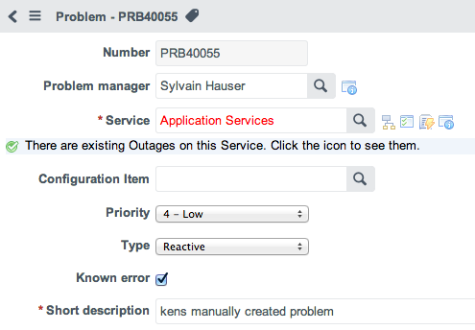
Outage detection
2
1
When the selected Service or CI has ongoing outages, the field content is displayed in red as well as an information message.
The Show Outage decoration icon is also displayed allowing to look up the ongoing outages on the selected Service or CI

Slide 30
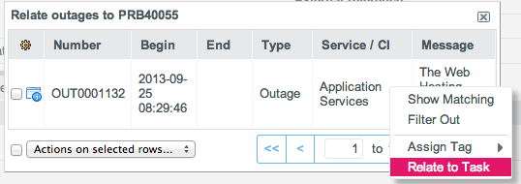
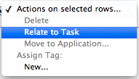
Outage look up and relate
2
2
1
Clicking the Show Outage button displays a list of ongoing outages on the selected Service or CI
Right-click on an Outage and select “Relate to Task” in the contextual menu to relate the selected Outage with the current Problem
Multiple outages can be related to the current Problem at once using the tick boxes and the drop down action list

Slide 31
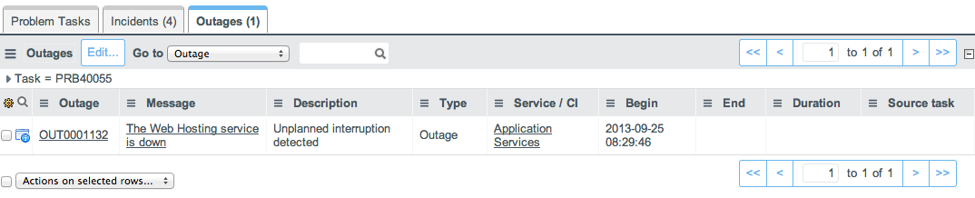
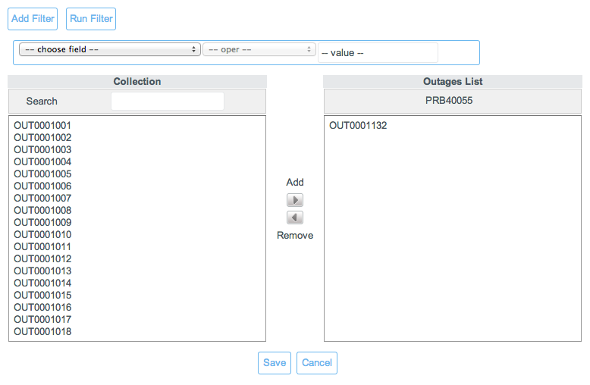
Related Outages
1
Related Outages are displayed in the “Outages” related list at the bottom of the Incident form
Use the “Edit” button to relate the current Problem to other existing Outage(s)
Use the slushbucket interface to add or remove related Outages to/from the current Problem
2

Slide 32
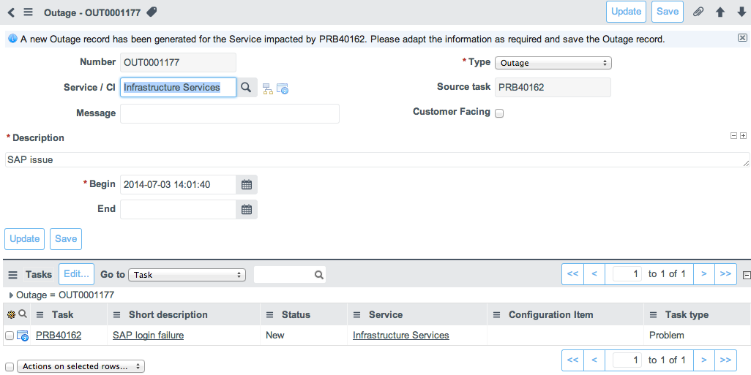
Outages creation
Outages can also be created directly from a Problem form
Right-click on the form header bar and select “Create Outage” in the contextual menu
A pre-filled outage record is created using the Impacted Service.
The created outage is automatically related to the originating Problem

Slide 33
Additional Functionalities
Known Error DataBase (KEDB)

Slide 34
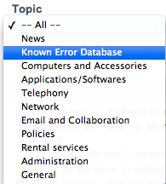
Publishing a known error KB Article
A Known Error KB article can be created directly from a Problem record marked as a Known Error
Right-click on the form header bar and select “Publish to Known Error KB” in the contextual menu
The content of the Known Error description and workaround fields is used to populate the KB article (which is then referenced in the Known Error KB Article field)
Known Error articles can be found by IT agents in the KB “Known Error” Category and can be looked up in the Incident short description quick search function

Slide 35
Managing known error KB Articles
Known Error KB Articles can only be updated by updating the Problem from which it was created
Updating the Problem’s “Known error description” and “Workaround” automatically updates the related Known Error KB Article
A Known Error KB Article related to a Problem can be archived or re-published by changing the state of the “Known error” flag:
Un-checking the flag will archive the KB Article
Re-checking the flag will re-publish the KB Article

Slide 36
Exercices

Slide 37
Exercise - Create new problem (Reactive)
Log a new problem from an incident as ITIL user
Log in as ITIL User
Open the related incident
Mouse over “Incident” label in heading and select “Create Problem”
Fields copied are: “Service”, “CI”, “Short Description”

Slide 38
Exercise - Create new problem (proactive)
Create a new problem as ITIL user
Log in as ITIL User
Caller : “Joe Employee”
Problem > "Create New”
In the “Service” field search for the impacted service
If known, select the “CI” impacted by the problem
Update the problem “Short Description”

Slide 39
Exercise – problem control
Review the problem as ITIL manager
Log in as ITIL Manager
Check the application “Problem” and Module “Open” for new problems
Update “Assigned to” field to self
Change “Problem Status” from “Open” > “Resolved”
Verify “Short Description” and “Description” Fields
Verify related incidents (“Incidents” related list at bottom of problem form)
“Priority” > Select from list
Document workarounds using the “Workaround” field and communicate using UI Actions (Communicate Workaround, Publish Known Error KB)
Evaluate different workarounds and update “Work notes” (internal)
Document “Root cause”
Document permanent fix in the “Solution” field
Tick “Known Error”
Click on “Update”

Slide 40
Thank you
Notes:
Click on the Apptio Logo to launch the hidden Waiting Slide.

